Slide 1
Project Work
PROJECT EXPERIS
KILOMETRO ROSSO – 21/05/2018
Running a maze
Marco Stucchi

Slide 2
Getting the source code
PROJECT EXPERIS
Online repositories

Slide 3
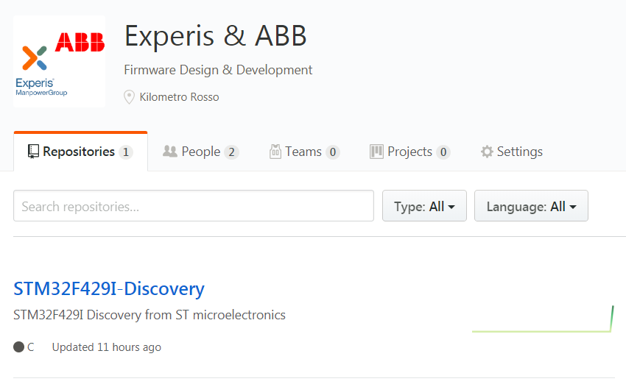
Github repository
https://github.com/experisABB

Slide 4
SourceTree
GIT GUI for Windows & MAC
https://www.sourcetreeapp.com/ to download specific version
Installation
Accept License Agreement
Login with Atlassian account (don’t have an account ? Sign up for one)
Download and Install tools (Git + Mercurial)
Use default ignore file
Skip SSH key

Slide 5
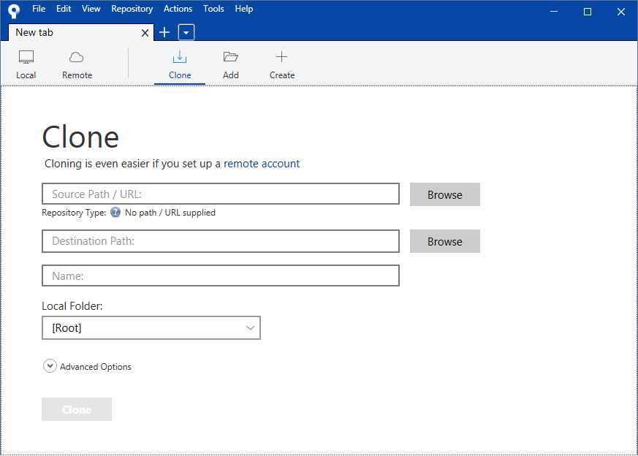
SourceTree
Connecting to Github

Slide 6
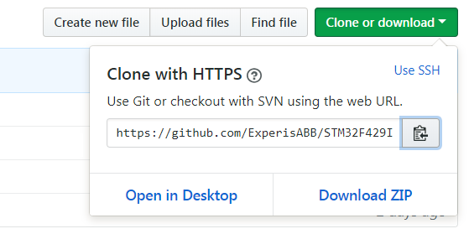
SourceTree settings
Source Path / Destination Path
Get the Source Path URL from the «Clone or download» menu in Github repository
Set the Destination Path as desired on the local machine

Slide 7
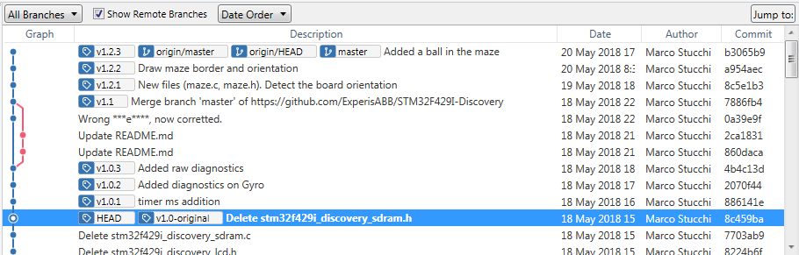
SourceTree
Select Starting Tag
Double click on the «v1.0-original» tag
The empty circle indicates the checkout on the selected Tag

Slide 8
Demo Application
PROJECT EXPERIS
STM32F429I Discovery Board

Slide 9
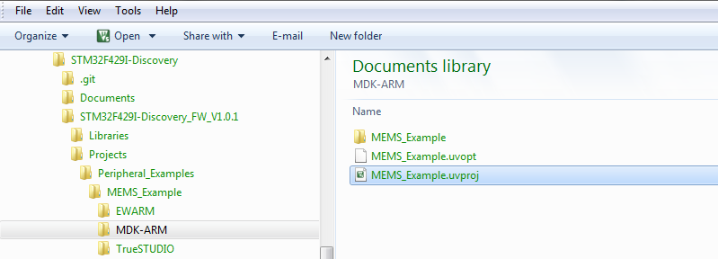
Getting the Project
MDK-ARM Project
Project file: MEMS_Example.uvproj
Can be found under {Destination Path}

Slide 10
Project v1.0-original – ST Microelectronics original code
Getting familiar with the code
Release: v1.0-original

Slide 11
Possible bug ?
Check the behaviour
Occasional glitch in the detected direction
What can we do ?
Let’s instrument our code..
..and check the axis rotation in a buffer of 256 values
..an array of values taken from Buffer[1]

Slide 12
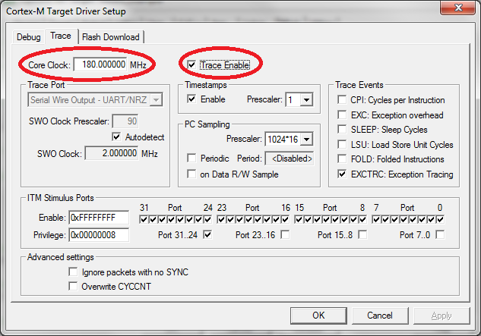
Run-time debugging
Make the correct settings

Slide 13
Run-time debugging (timer_ms)
Insert variable that counts ms
Attach to specific ISR (which one ?)
Check timer interrupt interval
Execute Gyro reading on timer change
Release: v1.0.2

Slide 14
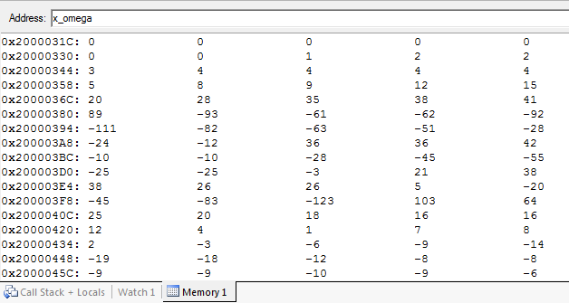
Buffer debugging
Anything strange ?

Slide 15
Additional debug
Check the behaviour
Check the raw data to see if there is a match
Let’s instrument our code..
..and check the raw axis rotation in a buffer of 256 values
..an array of values taken from RawData[1]
Let’s align in two memory windows and compare
What’s the relation between the two buffers ?
Release: v1.0.3

Slide 16
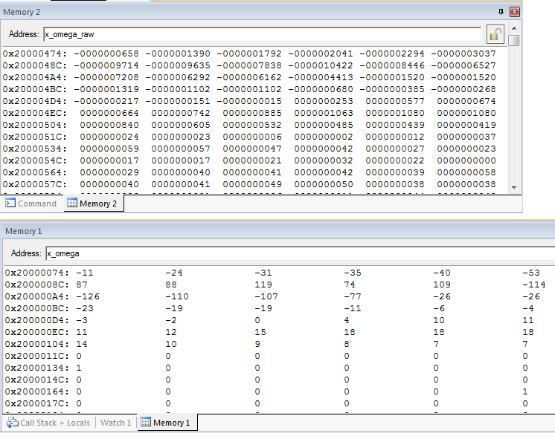
Raw Data
Wrong scaling factor ?

Slide 17
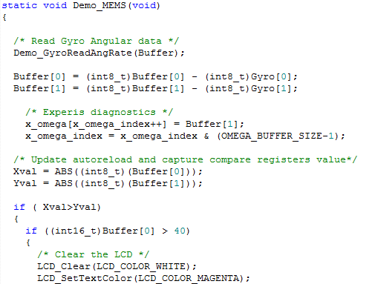
Bug found
Typecast confusion
Release: v1.1

Slide 18
Maze
PROJECT EXPERIS
STM32F429I Discovery Board

Slide 19
Orientation
State Machine
Maze_GetNewOrientation
Return bool. true = Orientation updated
Parameters : float XSpeed, float Yspeed
Xspeed = Buffer[0], Yspeed = Buffer[1]
Xspeed → Up, Down
Yspeed → Left, Right

Slide 20
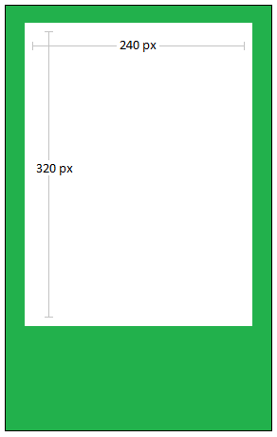
Basic drawing
ST Disco driver
Based on ILI9341 single chip driver
ST Micro libraries (no emWin)
Basic functions:
LCD_SetTextColor
LCD_DrawRect
LCD_FillTriangle

Slide 21
Available Colors
ST Disco driver
0x0000 Black
0xFFFF White
0x051F Light Blue
0xF800 Red

Slide 22
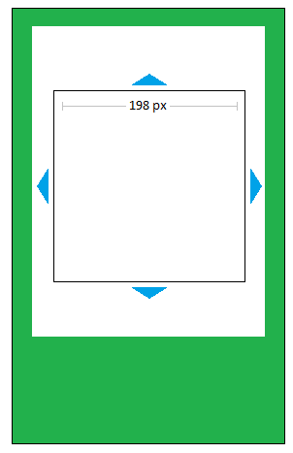
Draw border and Direction
Center in the middle of the display
Outer size = 198
Arrow size (base = 36, height = 12)

Slide 23
Draw border and Direction
Maze structures
Release: v1.2.2

Slide 24
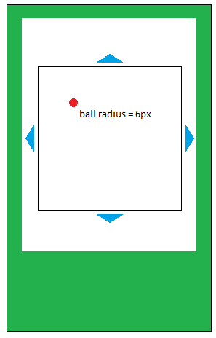
Add a ball in the maze
New files: ball.c/ball.h
Color Red (0xF800)
Add cinematic
Acceleration (e.g. 60 pixels/s^2)
Deceleration (e.g. 15 pixels/s^2)
Speed (e.g. speed max = 120 pixel/s)
Position (manage borders)
Radius = 6 px
On border impact: rebound
Semi-elastic rebound

Slide 25
Add a ball in the maze
New functions
Ball_Adjust_aVS(eOrientation)
Maze_DrawTheBall( uint x, uint y)
New class, Ball
float x_accel, y_accel
float x_speed, y_speed
Float x_position, y_position
Used graphic function:
LCD_DrawFullCircle(ushort X, Y, radius)
Release: v1.2.3

Slide 26
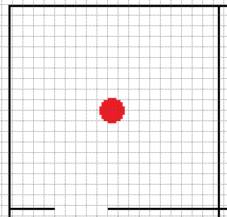
Improve the border check
Let’s think about something different
New algorithm suitable for a maze
Req: maze knowledge not required
Any ideas ?
Readback from the LCD memory !!
Take a look at the library
New functions:
Ball_closeToWall ( which direction ?)
Ball_CheckProximity
Release: v1.2.4

Slide 27
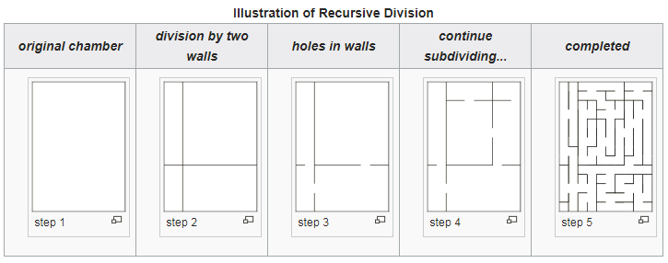
A Maze, finally
Let’s start drawing a maze
Different automatic maze algorithms are possible
Recursive Division:
Divide in 4 rooms
Make 3 openings
Iterate

Slide 28
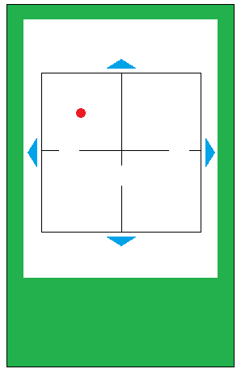
A Maze, finally
Let’s start drawing a maze
Let’s start with something like this:
Single iteration
Divide the screen in 4 rooms
Make 3 holes wherever you want
The new proximity algorithm should already work
New function: Maze_DrawInner
Possible cinematic adjustment (e.g. deceleration)
Release: v1.2.5

Slide 29
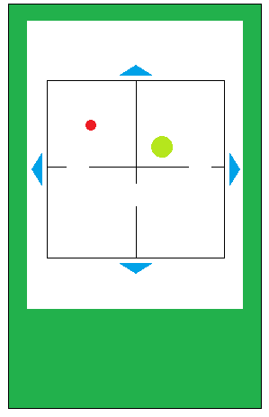
There’s a hole in my maze
Let’s place a destination for the ball wandering
Hole radius = 12 pixels
Add the hole position to the maze structure
New function: Maze_DrawHole
Release: v1.2.6

Slide 30
Final touches
Avoid bouncing into the hole
When the ball enters the hole, it is trapped
And more….
Real games need a time
Store best times in a non volatile memory
You name it..
Release: v1.2.10

